Slide 1
About this template
This template is designed to give you a starting point for your conversation.
Please adapt the slides as appropriate for your audience, add in others or remove those that don't seem relevant.
Remember, this conversation aims to inspire action and discuss solutions!
[Delete this slide!]

Slide 2
Joining the conversation

Slide 3
Welcome and check in
Introductions
What is Nature's Workforce
Mapping what you do
Imagining what could be
Finding the next step
Summary

Slide 4
Nature's Workforce
Created by WWF, RSPB and the National Trust, Nature's workforce is about driving change within businesses through the power of employees and internal action.
In the UK we've lost nearly half our wildlife. The UK has one of the lowest remaining levels of biodiversity on Earth.
But businesses can make a big difference. Through looking at how we do business, we can drive a nature positive and net zero future.

Slide 5
Nature's Workforce
Why does taking action for nature matter in your business?

Slide 6
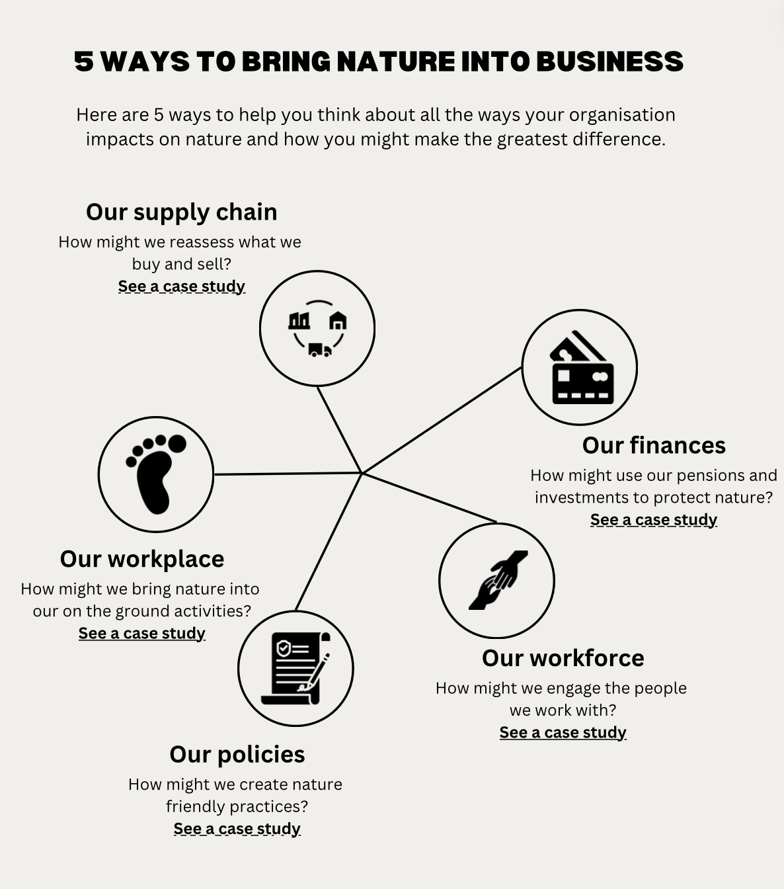
Mapping what you do
Introduce the one way [workplace, finance, supply chain, people or policy] that your business impacts nature. Or ask the team to help you decide which one to focus on

Slide 7
Mapping what you do
Using the 5 ways in, what questions would you like to answer and how can you get involved?

Slide 8
Mapping what you do
Open up the floor to questions
What opportunities do people see emerging from this space?

Slide 9
Imagining what could be
Imagine you are reading your annual report in 5 years time and a heading reads ‘5 ways we have brought nature into our business’. What does it say? What are the images used?
What would you like to be able to tell the future generation that you did?

Slide 10
Finding the next step
What are the next steps to exploring the opportunities that have been identified in this session? What are the questions we are holding?

Slide 11
Summary
What is the focus area you've decided on?
What feels important from this conversation ? What are the next steps you're going to take

Slide 12
Thank you

